Slide 1
Adoption of Rules in Societies
Pandemia Simulation
Notes:
Hello everyone,
My colleague and me, We want to talk about our topic concerning electromobility in Switzerland.
As you know, there are more and more electric vehicles on the road.
For people who want to buy an electric car, there is always the same simple question:
Do we have enough chargers in Switzerland?
To answer this question, we will talk about this points

Slide 2
Summary
Presentation
Physical Models
Implementation
Conclusion

Slide 3
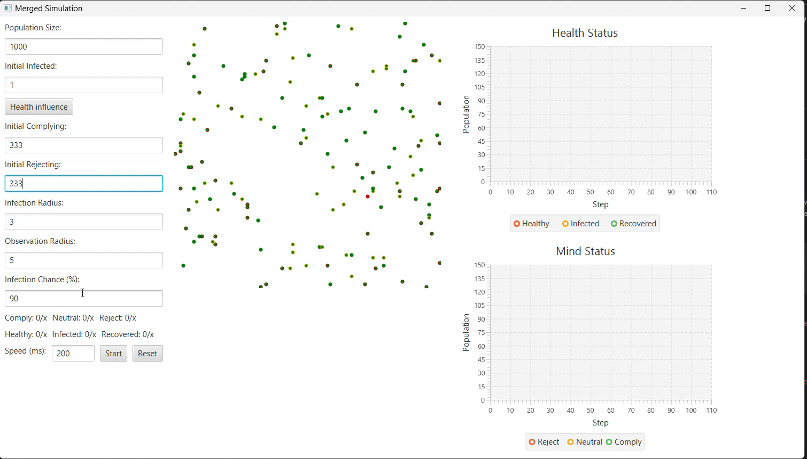
Presentation

Slide 4
Physical Model
Matrix: Prisoner Dilemma
Mindset | Near Comply | Near Neutral | Near Reject
Comply | 2 | 1 | -5
Neutral | 7 (if majority) | (+ if majority comply else -) 5 | 7 (if majority)
Reject | 5 | -5 | (+ if comply around else -) 2

Slide 5
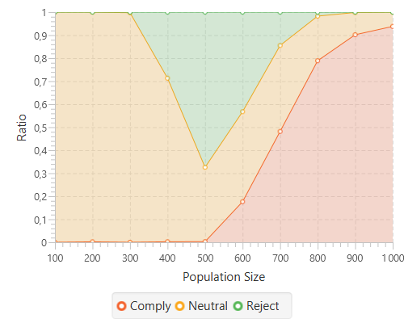
Physical Model
Results: 100 steps 10 times

Slide 6
Physical Model
Infection spread
Infected:
Behavior transmission factor
Virus transmission factor
Healthy: Can be infected
Recovered:
Safe and cannot be infected
After some time will return to Healthy

Slide 7
Physical Model
Matrix: Prisoner Dilemma
Mindset | Near Comply | Near Neutral | Near Reject | Near Infected | Near Healthy | Near Recovered
Comply | 2 | 1 | -5 | 2 | - | -1
Neutral | 7 (if majority) | (+ if majority comply else -) 5 | 7 (if majority) | 2 | - | -2
Reject | 5 | -5 | (+ if comply around else -) 2 | 2 | -1 | -2

Slide 8
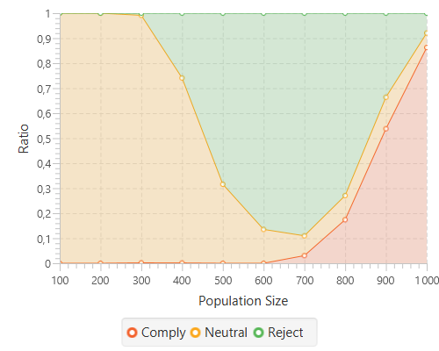
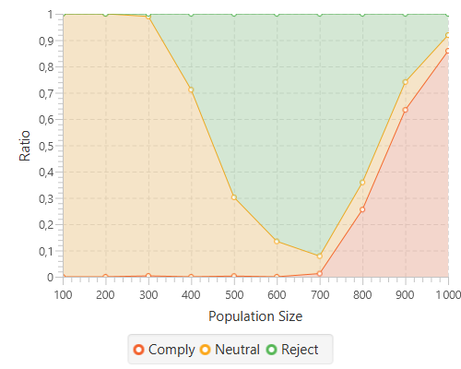
Physical Model
Results: 100 steps 10 times
No infection
10% infected at start

Slide 9
Implementation
Behavior/ ├── BehaviorPropagationExample.scala ├── BehaviorSimGUI.scala
Virus/ ├── VirusPropagationExample.scala ├── VirusSimGUI.scala
Pandemia/ ├── PandemiaPropagationExample.scala ├── PandemiaSimGUI.scala ├── PandemiaSimPlot.scala ├── PandemiaSim.scala ├── PandemiaTransition.scala

Slide 10
Implementation
Sealed Trait
Map
Iteration over the vector of agents
Match Case
Select action according of status
FoldLeft
Compute infection
Compute results of simulations
ScalaFX
GUI

Slide 11
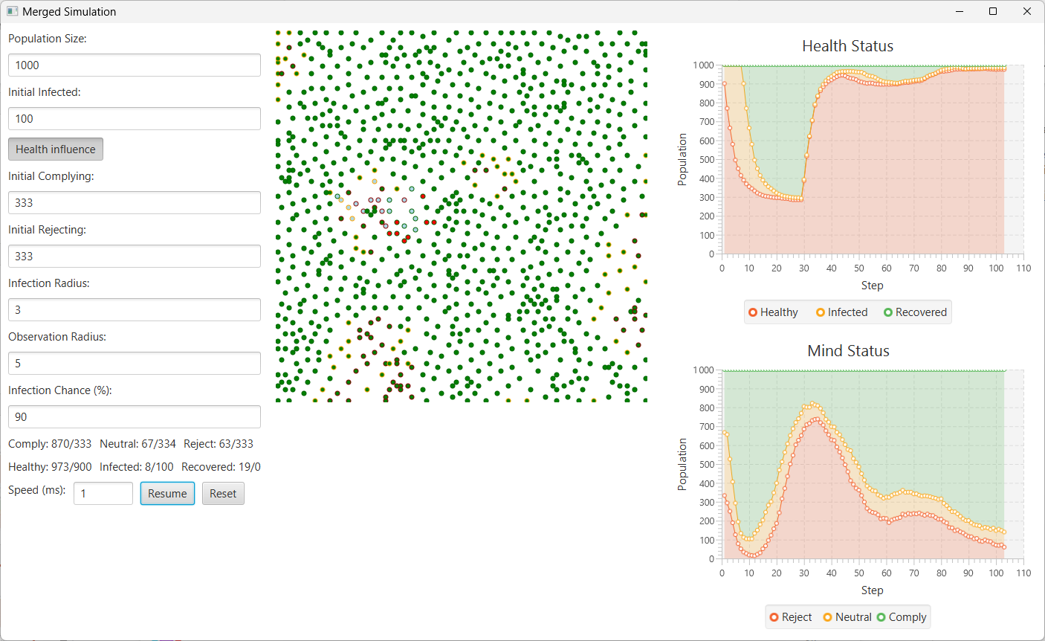
Conclusion

Slide 12
Conclusion
No infection
10% infected at start

Slide 13
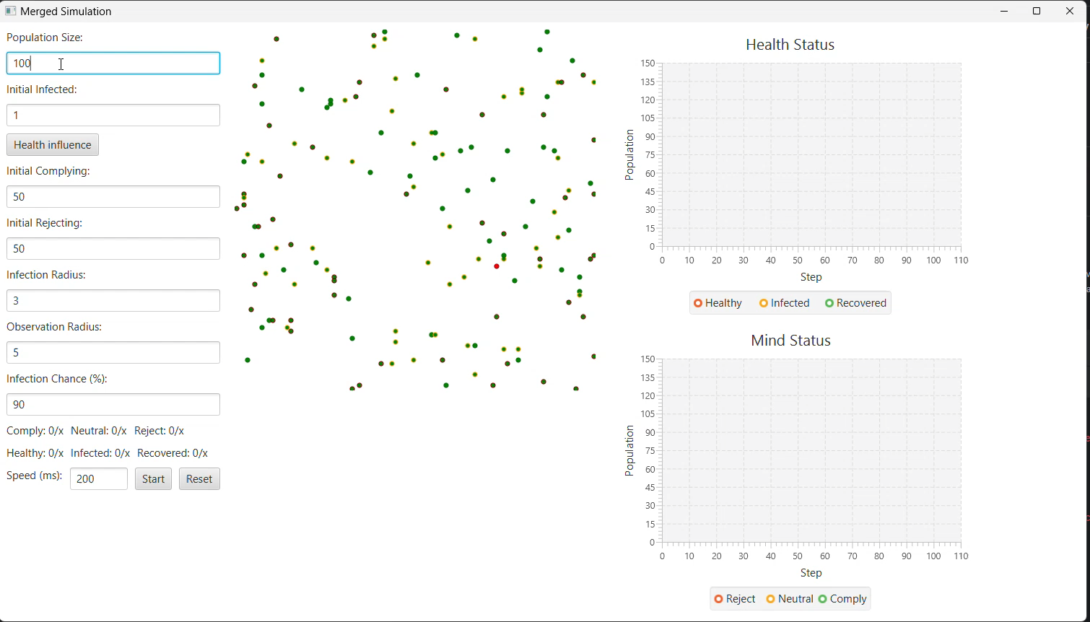
Questions

